Slide 1
Introduction to Web and Frontend
05/01/2022 By Prachi Pandya
Notes:
Introduction to Team
The web app & Why web app?

Slide 2
Agenda
Evolution of World Wide Web
Application types
Javascript
Typescript
The framework era
Angular details
Questions

Slide 3
Evolution of World Wide Web
Web 1.0 (1990’s)
No dynamic content
JavaScript/CSS in their infancy
Major Players: Netscape & IE
Web 2.0 (2000’s)
Dynamic HTML
JS/CSS to manipulate DOM
Drag-n-Drop & animations
Examples:
Amazon
Wikipedia
Youtube

Slide 4
Evolution of World Wide Web
Web 3.0 (2014)
Use of AI to understand the content on web
Examples:
AI, blockchains, crypto
Virtual and augmented reality

Slide 5
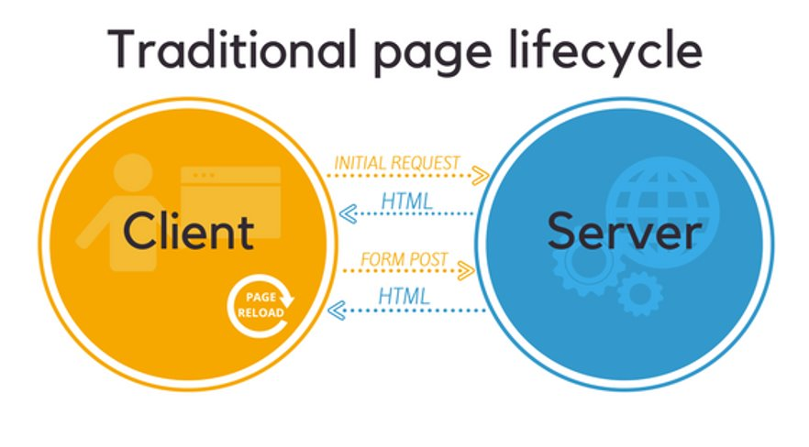
Application types- MPA

Slide 6
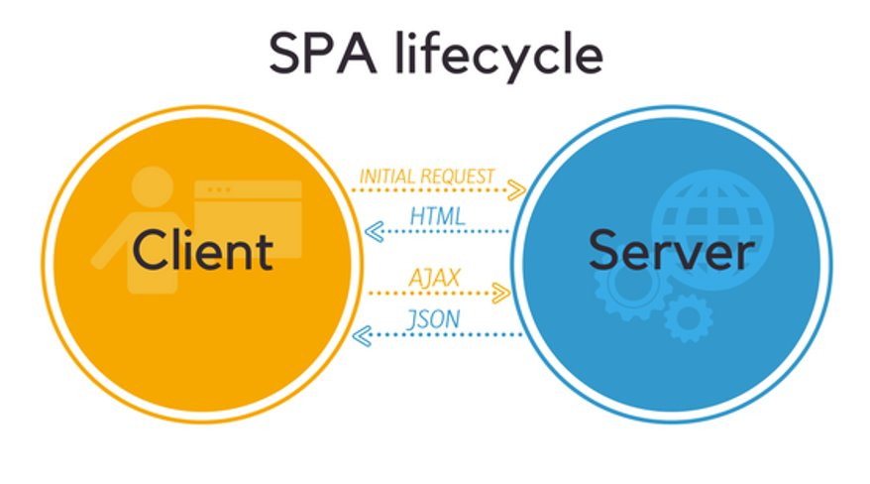
Application types- SPA

Slide 7
JavaScript
Notes:
Difference between a Programming language, Library and a Framework

Slide 8
What is JavaScript?
Cross-platform
Object-oriented scripting language
Used to make webpages interactive
Client-side JS
Place elements on an HTML form
Respond to user events such as mouse clicks, form input, and page navigation
User input validations
Example- Angular, React, Vue
Server-side JS
Application to communicate with a database
Perform file manipulations on a server
Create servers to receive data from firmware
Example- Node.js
Latest version- ES6

Slide 9
Important JS concepts
Scope
IIFE (Immediately Invoked Function Expression)
Hoisting
Closures
Callbacks
Promises
Async and await
Asynchronous
Event loop
Why is JS single-thread language?

Slide 10
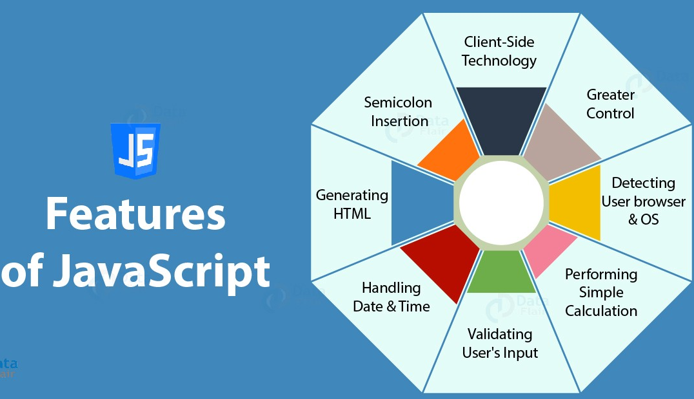

Slide 11
Typescript
Notes:
Difference between a Programming language, Library and a Framework

Slide 12
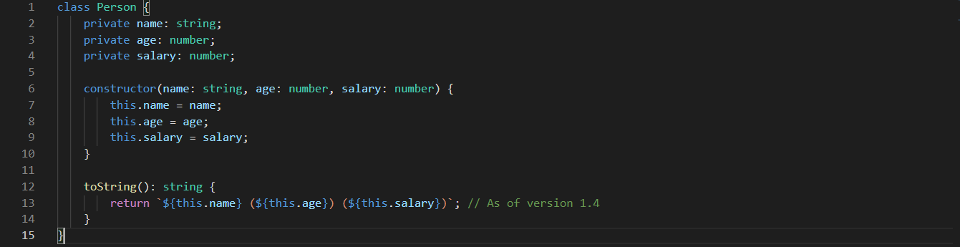
Typescript
Superset of JavaScript
Provides type definitions to your JavaScript code which makes the development process a lot faster and helps to catch bugs
Latest version: 4.5.4
Notes:
https://jsfiddle.net/ https://www.typescriptlang.org/play let a: string;
a = 1;
function getFullname(firstName: string, lastName: string): string {
// return firstName + ' ' + lastName;
return true;
}
console.log(getFullname(1, 2));

Slide 13
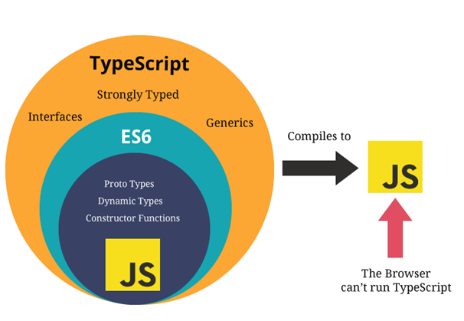
How is typescript understood by the browser?

Slide 14
The framework era
Notes:
Difference between a Programming language, Library and a Framework

Slide 15
Framework
A framework is a support structure or system that holds parts together, has something stretched over it or acts as the main structure
Example- Laravel, Angular, Ionic, TensorFlow, Xamarin, Flutter
Why use framework?

Slide 16
Framework
Assists in establishing better programming practices
Code is more secure
Duplicate and redundant code can be avoided
Several code segments and functionalities are pre-built and pre-tested
The time required to develop an application is reduced significantly
Gives our application clean structure
Includes a lot of re-usable code
Makes our application more testable

Slide 17
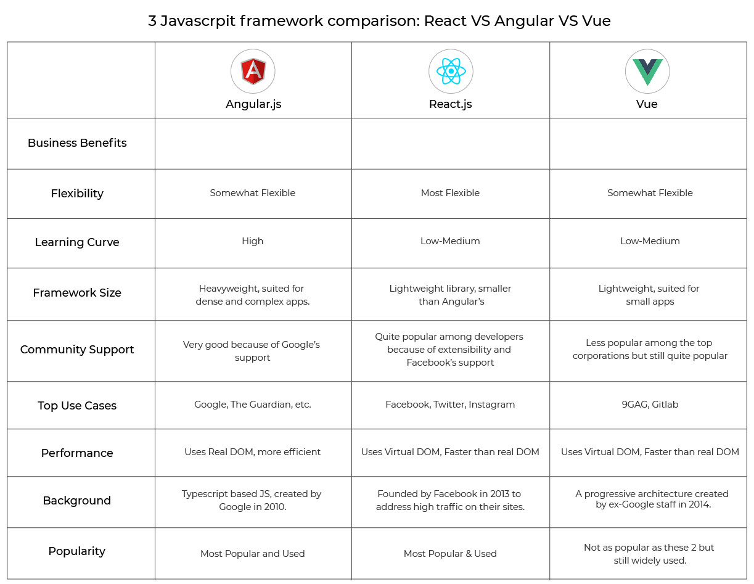
Comparing frameworks

Slide 18
What is Angular?

Slide 19
Angular is a framework for building client-side applications in HTML, CSS and JavaScript/TypeScript
Notes:
TypeScript is more advanced version of JS having OOP features

Slide 20
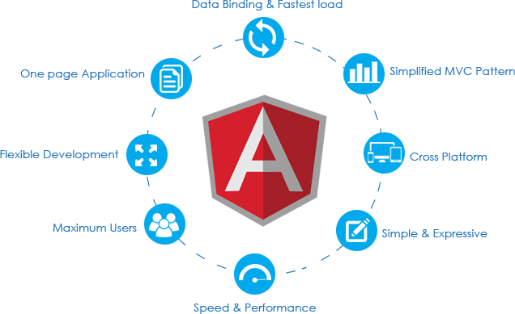
Features of Angular

Slide 21
MVC Architecture

Slide 22
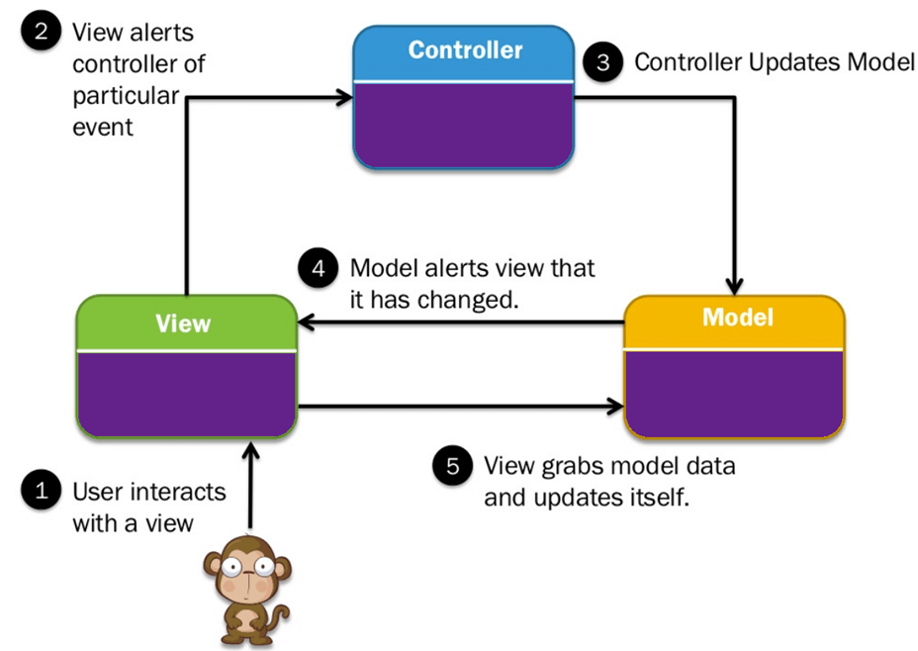

Slide 23
Questions?

